Slide 1
College Connect
Erin Colgrove, Jackson Tisler, Matt Betanski, Tyler Freeman

Slide 2
FileIO
Handles the file structure and creating Person/Club objects
Consists entirely of static methods
startUp method creates the necessary files right away during runtime if not already present
When the program calls FileIO.readProfiles(), the program looks at the personIdFile.txt and starts reading the lines of the file
Each line corresponds to a folder inside resources/profiles
The program then looks inside the respective folder and reads the contents of account.txt and uses this to create Person objects

Slide 3
RunnerGUI
GUI part of the project
Multi-threaded
The main thread is what takes care of most of the functionality
The second thread only takes care of time-based updates, such as updating the messages in the FindRoommatePanel
Uses JFrame
Has lots of inner classes for the different panels and such shown
Utilizes reflection in the EditInformationPanel

Slide 4
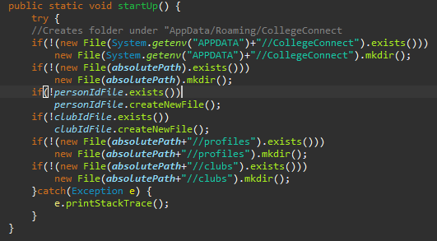
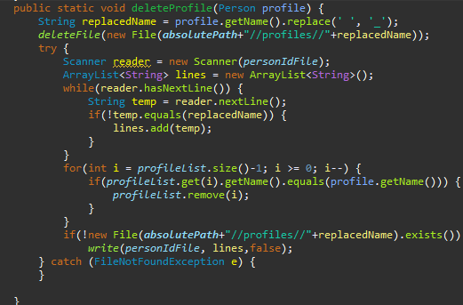
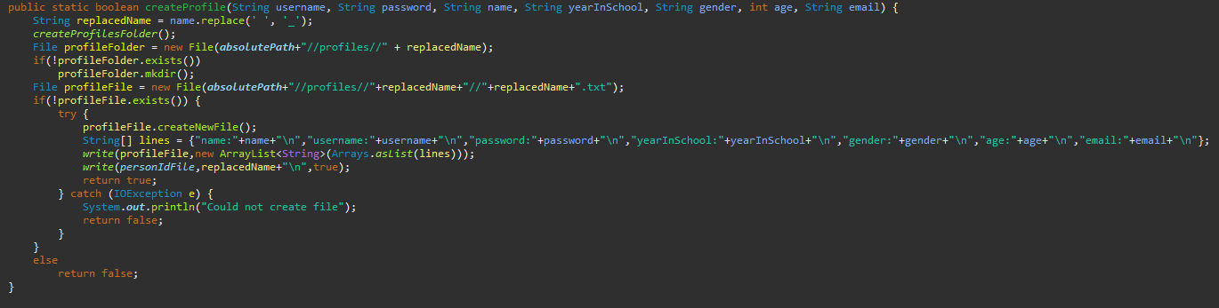
Code

Slide 5
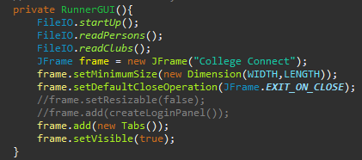
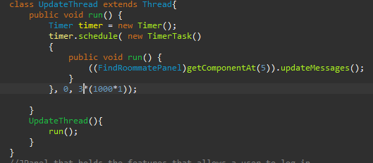
More Code

Slide 6
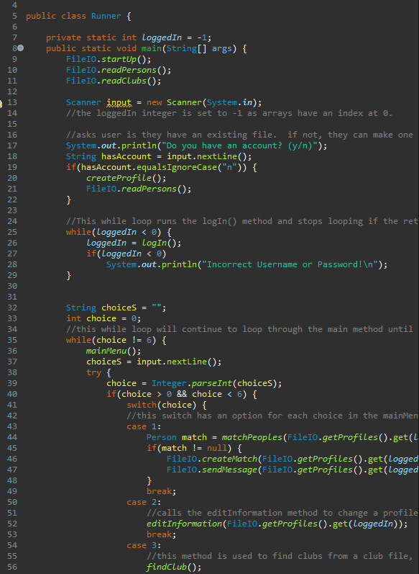
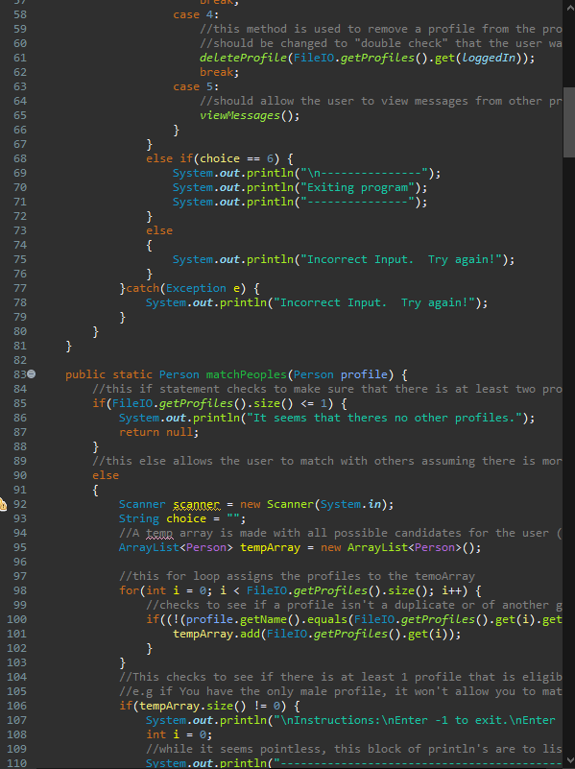
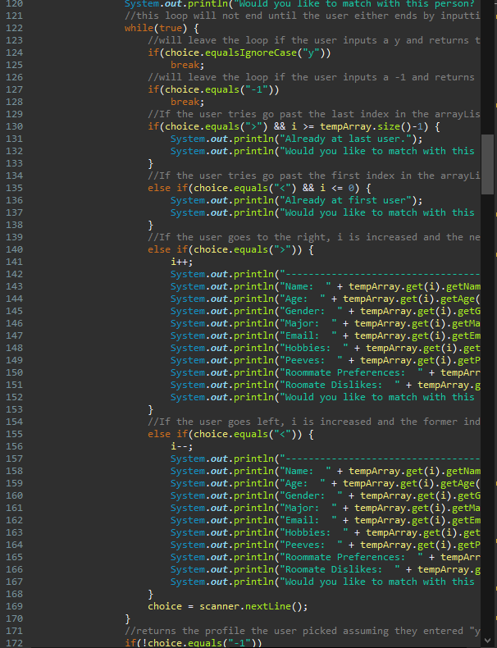
Runner

Slide 7
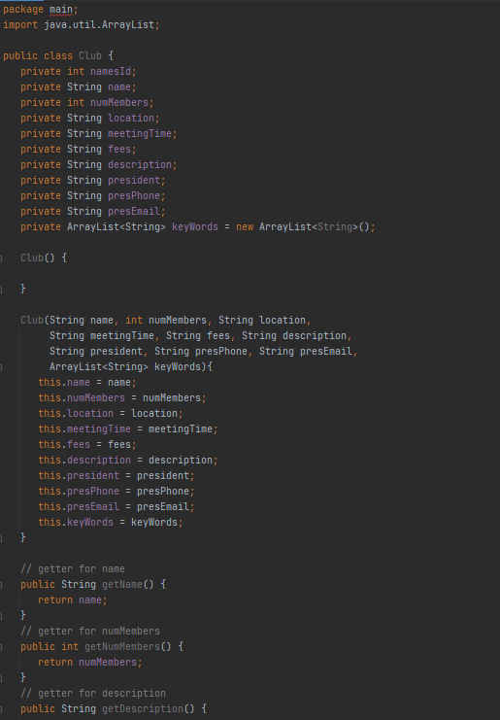
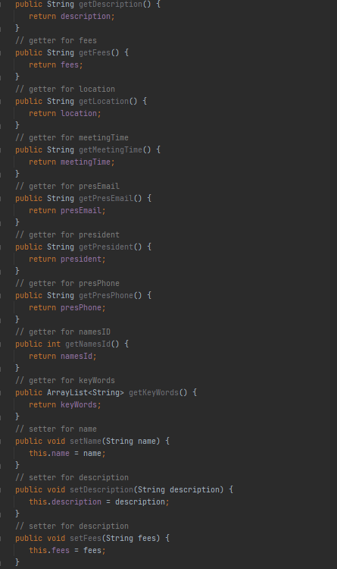
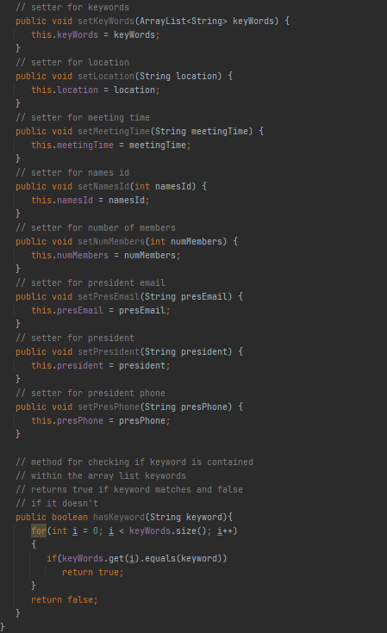
Club Class

Slide 8
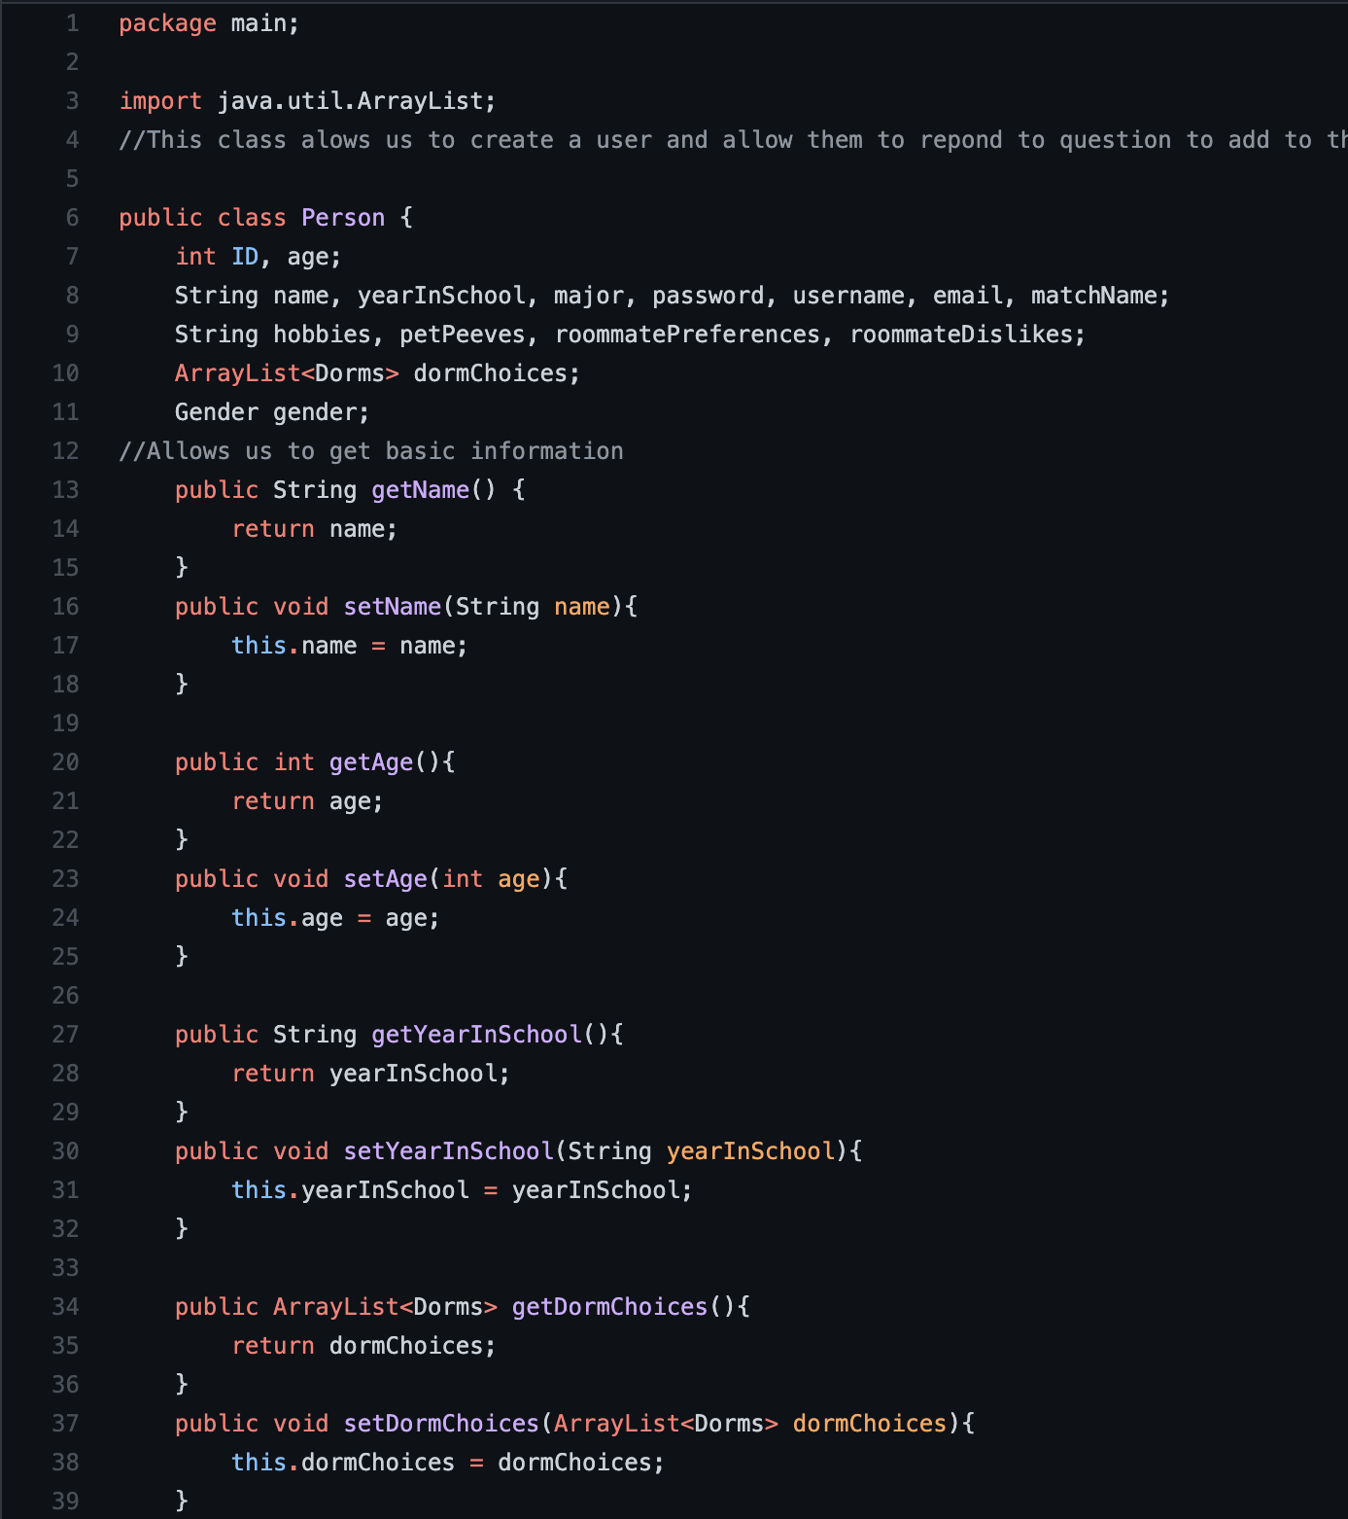
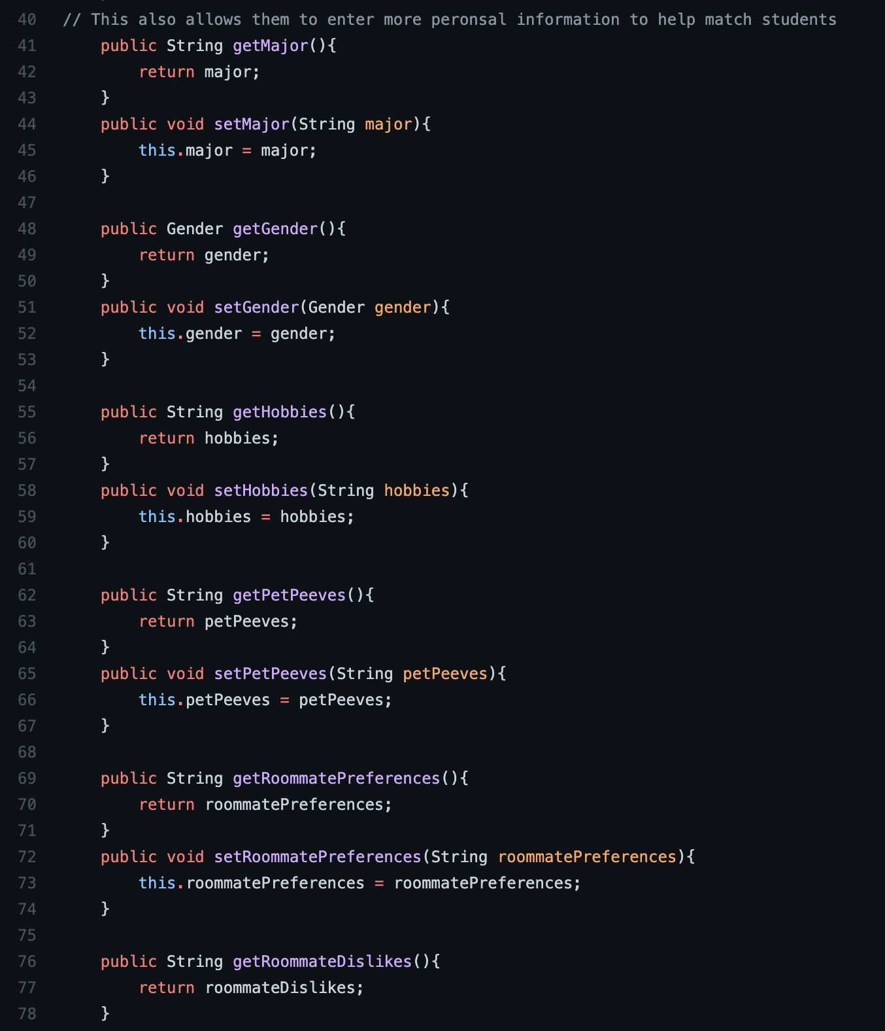
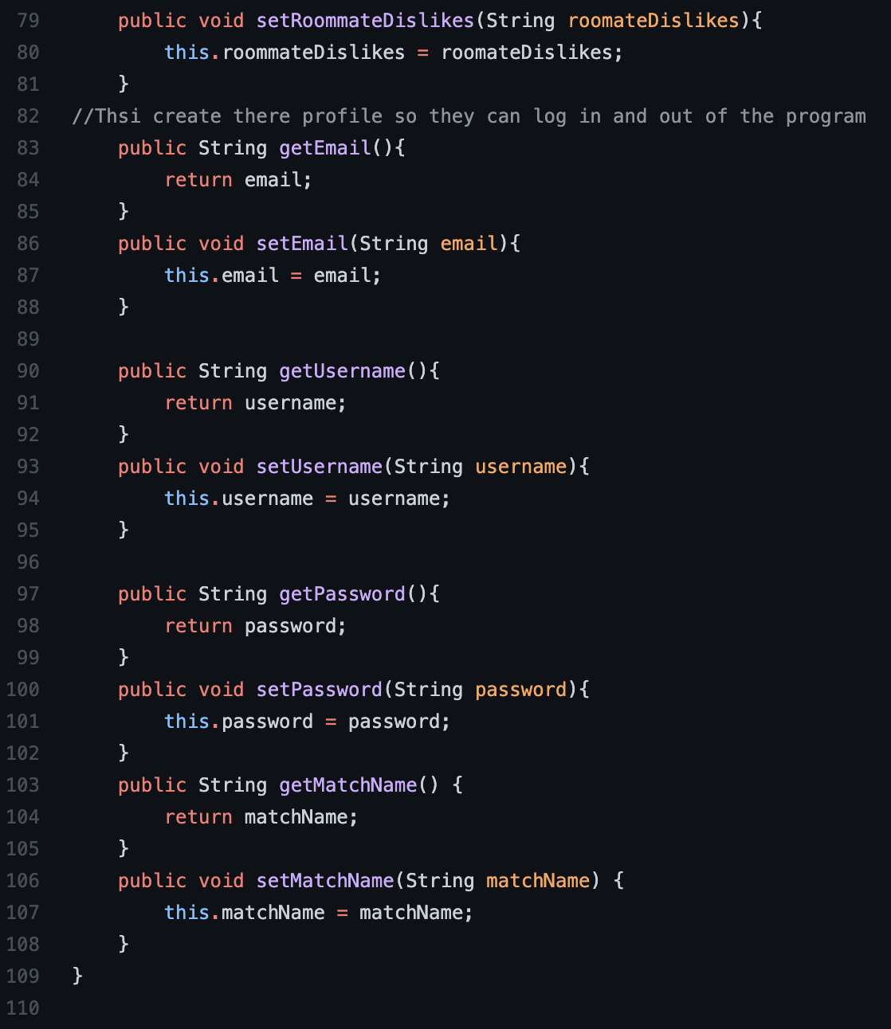
Person Class

Slide 9
Issues
There are some (currently small) issues within the program
The program creates a list of all the profiles at the start, which is only modified if the current user deletes their account
If a new user creates a profile, it would not appear on other users ends until the next time they started
At the same time though, if a different user deleted their account, this could impact other active users with the messaging features, because these rely on scanning text files, which can be modified during program runtime
The UI looks really bad and doesn’t have good sizing for elements
None of the UI is designed to change as the window resolution changes, so component locations stay static with regard to the top right corner

Slide 10
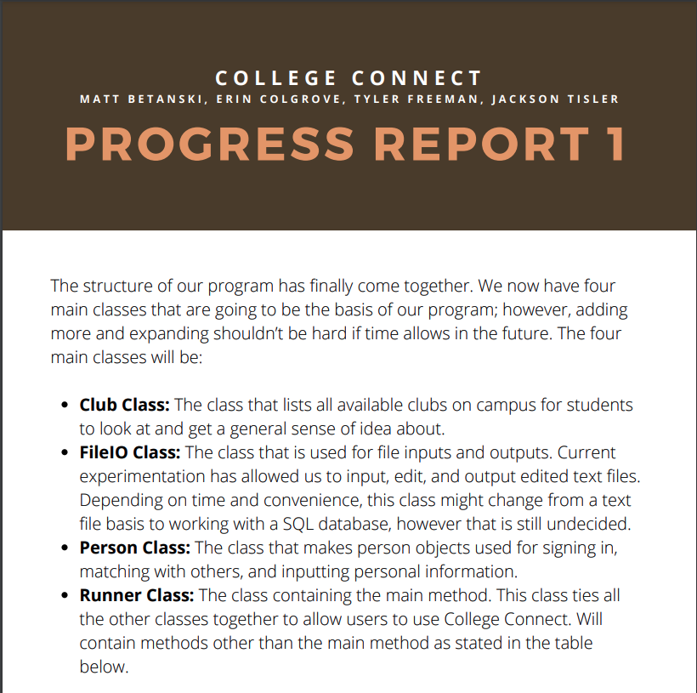
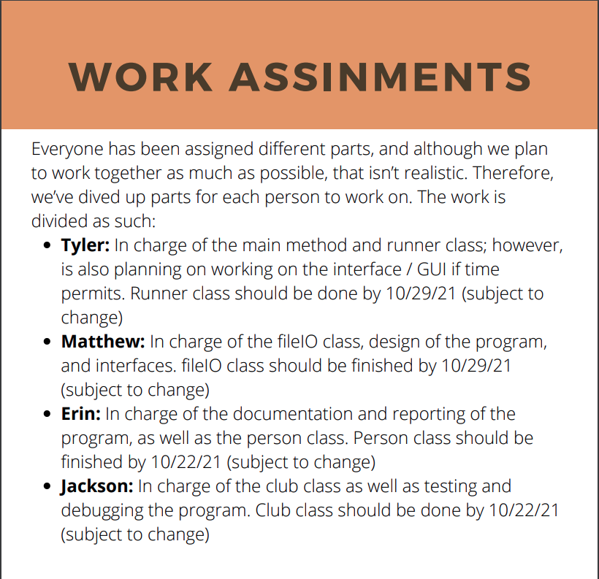
Progress Report1

Slide 11
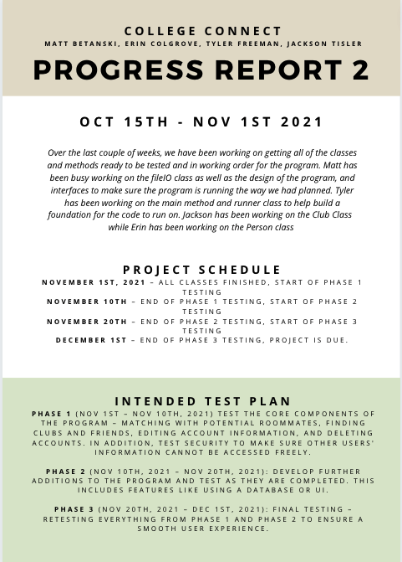
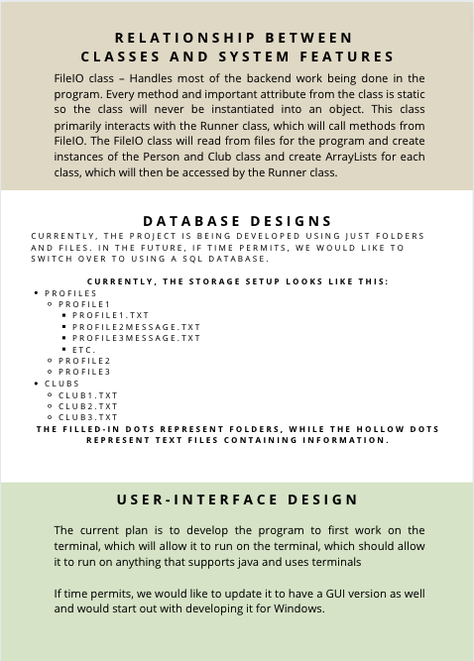
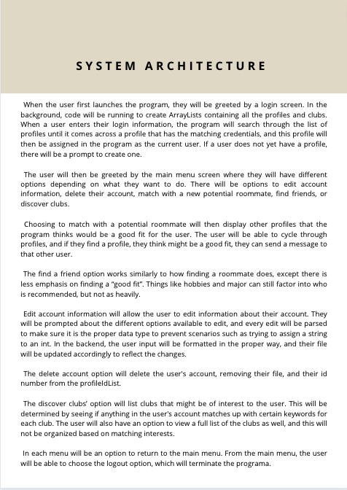
Progress Report 2

Slide 12
The Future
“points” system to help match users that have similar interests or roommate preferences/dislikes
Better messaging system
Rework parts of the program to better handle concurrence
Change file system to SQL Database
Allow a user to rename themselves
Now
Version 1.0
UI Redesign
Add Image Support
Handle null values in UI display
Mobile Applications
Website
Profanity filters
Add more club features
Joining clubs through the program, notifications
President can edit club info in program

